Slide 1
Book-Recommendation-System-Project
Team Members
Atharva P Abitkar
P. Devika rani
Tanveer Ahmed
Mudhigonda Shreya
Prajwal Pramod Jadhav
Sunkari Rahul

Slide 2

Problem Statement
During the last few decades, with the rise of Youtube , Amazon, Netflix, and many other such web services, recommender systems have become much more important in our lives in terms of providing highly personalized and relevant content.
The main objective is to create a recommendation system to recommend relevant books to users based on popularity and user interests.

Slide 3
Data Summary
The dataset is comprised of three csv files:: Users, Books, Ratings
Users_dataset.
User-ID (unique for each user)
Location (contains city, state and country separated by commas)
Age
Books_dataset.
ISBN (unique for each book)
Book-Title
Book-Author
Year-Of-Publication
Publisher
Ratings_dataset.
User-ID
ISBN
Book-rating

Slide 4
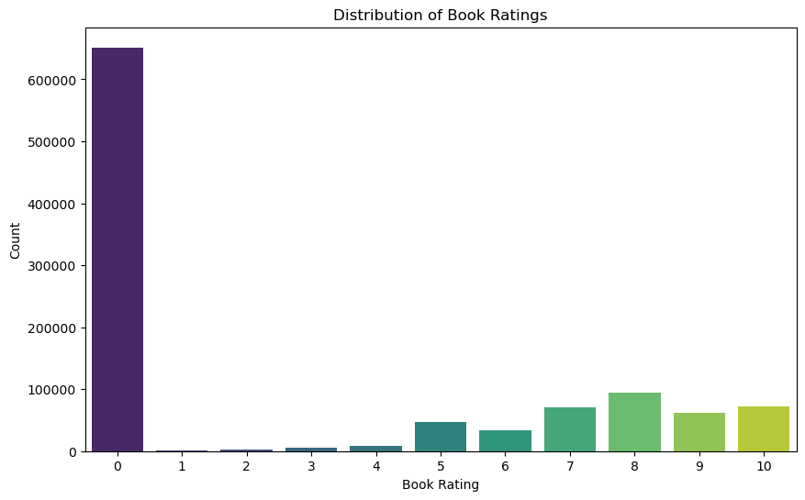
Observations from Users Most active readers are from column 0.

Slide 5
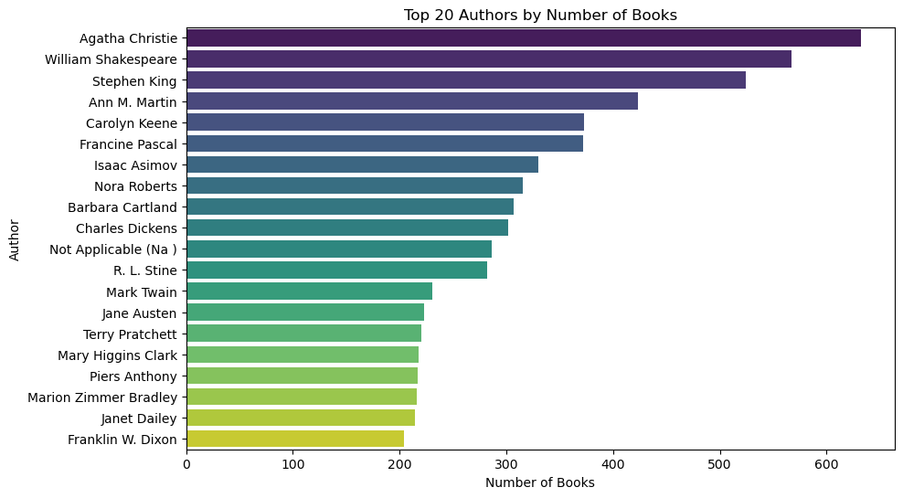
Observations from Book (Authors) Agatha Christie wrote highest number of books in our given dataset

Slide 6
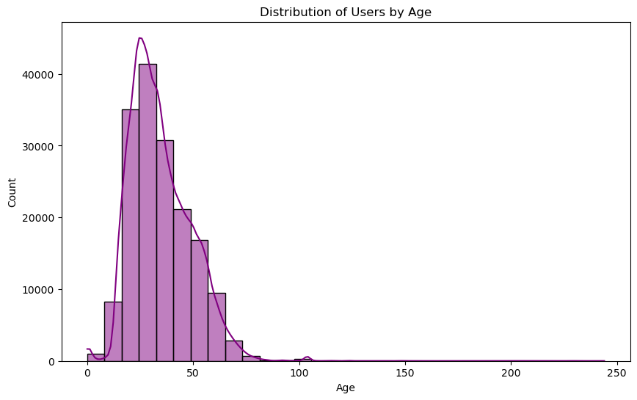
Distribution of users by age

Slide 7
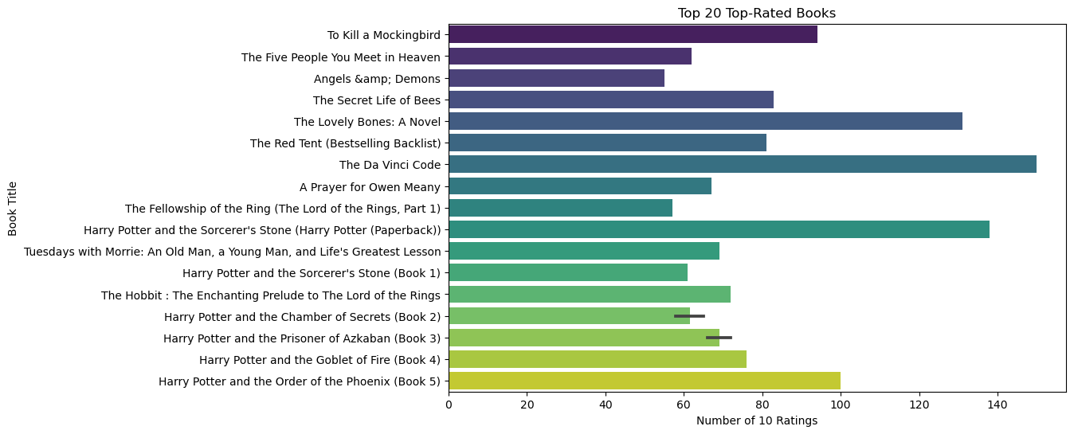
Observations from Book (Publishers) The Da Vinci Code is the Top-rated book in our given dataset. The Top five rated books are as follows: 1. The Da Vinci Code 2. Harry Potter and the Sorcerer’s stone(Harry Potter(Paperback)) 3. The Lovely Bones: A Novel 4. Harry Potter and the order of the Phoenix 5. To Kill a Mockingbird

Slide 8
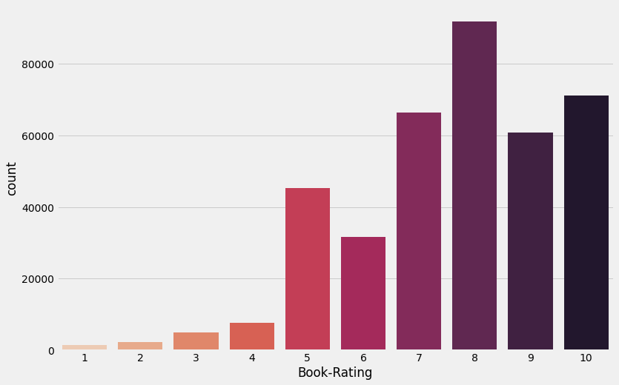
Observations from Ratings_df (Book_Rating) ● Higher ratings are more common amongst users ● Rating 8 has been rated the highest number of times

Slide 9
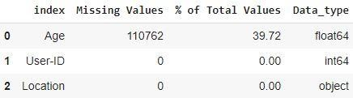
Data Cleaning 1. Null Value Imputation: Age column has 40% missing values

Slide 10
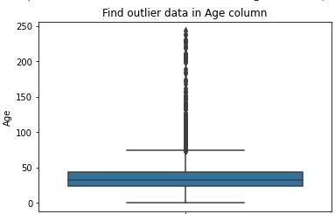
Imputing missing values Outliers in Age column Age has positive Skewness (right tail) so we can use median to fill Nan values,

Slide 11
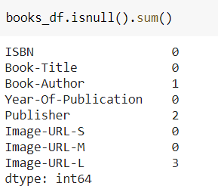
Data Cleaning 1. Null Value Imputation:

Slide 12
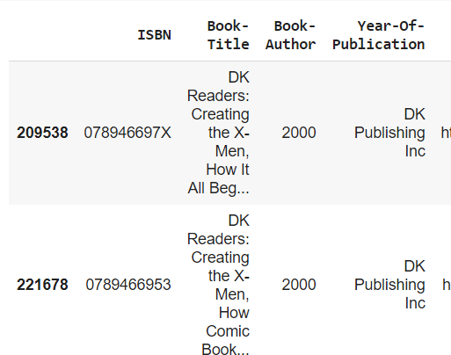
Replacing strings by int values

Slide 13
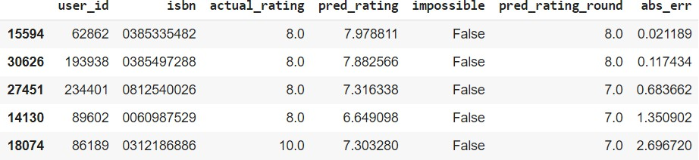
Different Models SVD Model Results

Slide 14
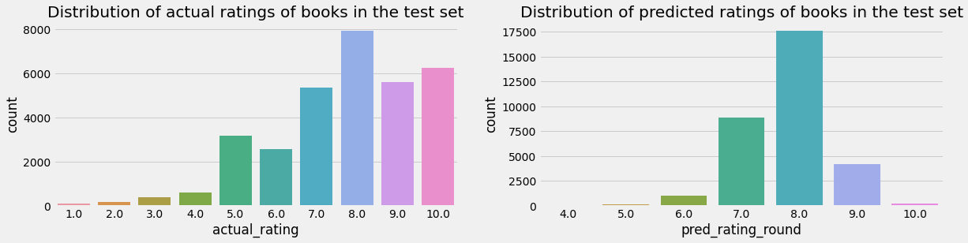
SVD Model Results

Slide 15

Different Models User-ID - 193458 Test set: predicted top rated books

Slide 16

Different Models Test set: actual top rated books

Slide 17
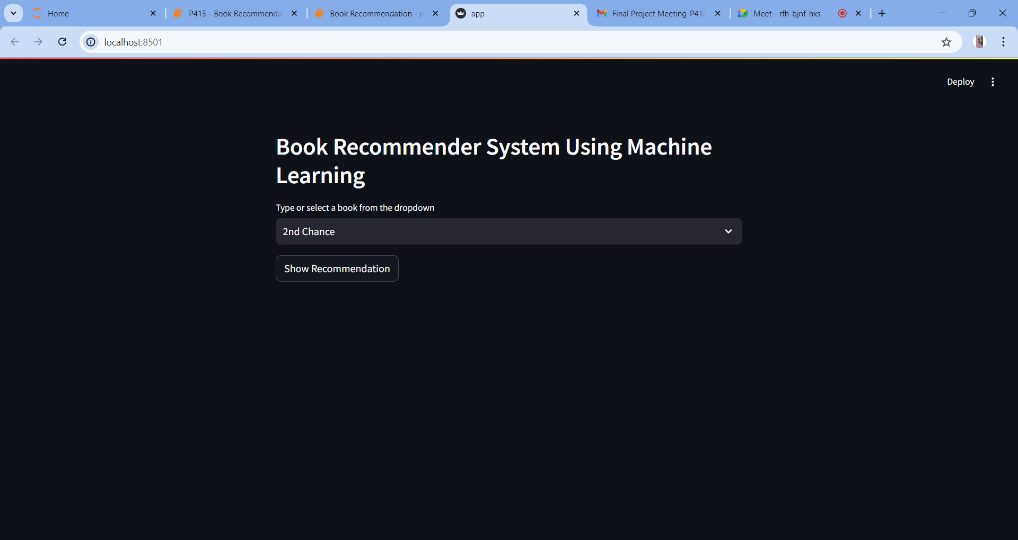

Slide 18
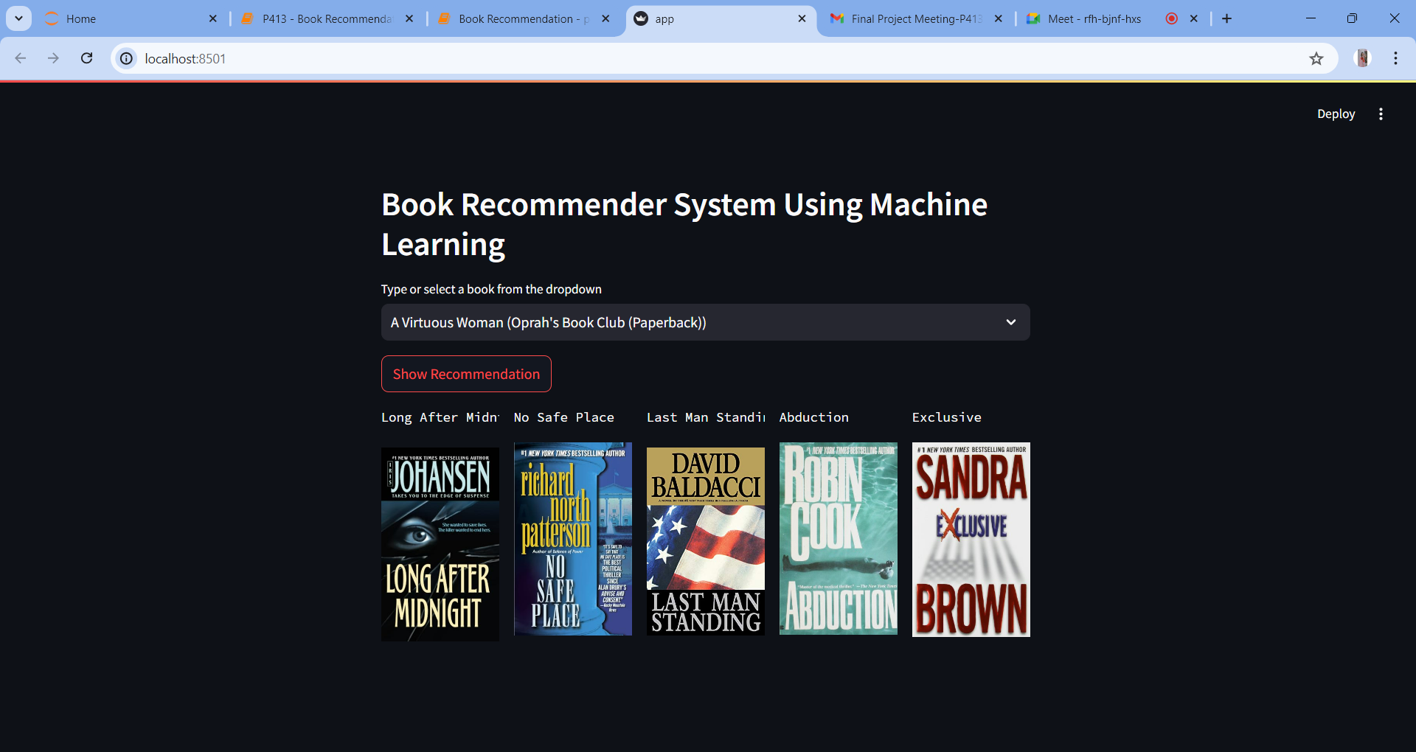

Slide 19
Conclusion
A recommendation system helps an organization to create loyal customers. The recommendation system today are very powerful that they can handle the new customer too who has visited the site for the first time. They recommend the products which are currently trending or highly rated and they can also recommend the products which bring maximum profit to the company.

Slide 20
Challenges
Handling of sparsity was a major challenge as well since the user interactions were not present for the majority of the books.
Understanding the metric for evaluation was a challenge as well.
Since the data consisted of text data, data cleaning was a major challenge in features like Location etc..
Decision making on missing value imputations and outlier treatment was quite challenging as well.

Slide 21
Future Scope
Given more information regarding the books dataset, namely features like Genre, Description etc, we could implement a content-filtering based recommendation system and compare the results with the existing collaborative-filtering based system.
We would like to explore various clustering approaches for clustering the users based on Age, Location etc., and then implement voting algorithms to recommend items to the user depending on the cluster into which it belongs.

Slide 22
Thank you!

